Slide 1

Finance for IT managers
International Masters
Spring 2018 program
© Sylvie Appriou

Slide 2
Sessions calendar
Session nb | Date | Time | Contents
1 | Thursday July 12th | 10:00– 13:00 | Introduction
2 | Wednesday July 18th | 10:00 – 13:00 | Home work review + class
3 | Wednesday July 25th | 10:00 – 13:00 | Home work review + class
4 | Wednesday July 25th | 15:00 – 17:00 | Exam

Slide 3
Course schedule and contents
Session 1
Introduction
Corporate Finance general concepts
Session 2
Planning and Budgeting, Cost Management
Case study
Session 3
Project value case
Case study

Slide 4
Article Calculating ROI for technology investments

Slide 5
ROI for technology investments
Value case or Business Case Analysis (BCA)
Based on a Cost / benefits analysis (CBA)
Used in the Go / NoGo decision for the project or in prioritization process…
Objections to BCA :
Hard to do…Requires large effort…
Subject to “gaming”….
Producing BCA :
Assess the future project benefits (ex : productivity savings, revenue generation)
Assess project costs
Produce financial metrics :
Net benefits
ROI
Payback period
Net Present value

Slide 6
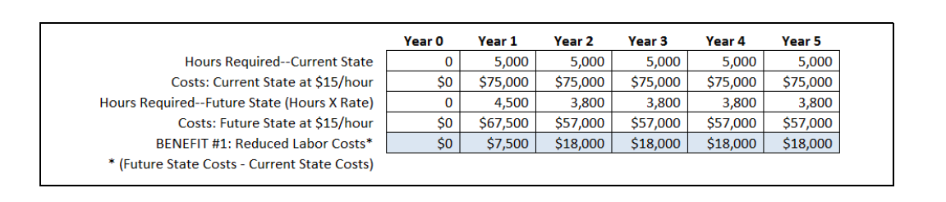
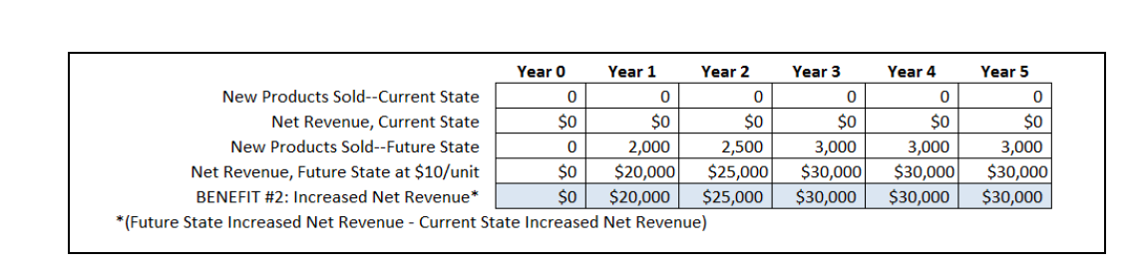
ROI for technology investments
Example : Purchase of a design SW will produce 2 benefits :
Decrease the time required to build product
Allow the building of a new product

Slide 7
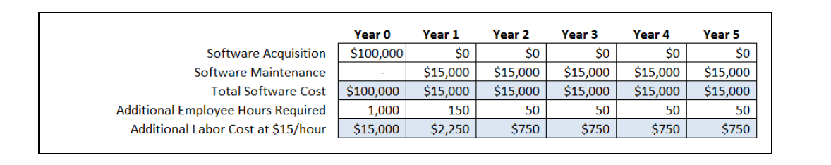
ROI for technology investments
Example : Purchase of a design SW will produce 2 benefits :
Estimation of project costs :

Slide 8
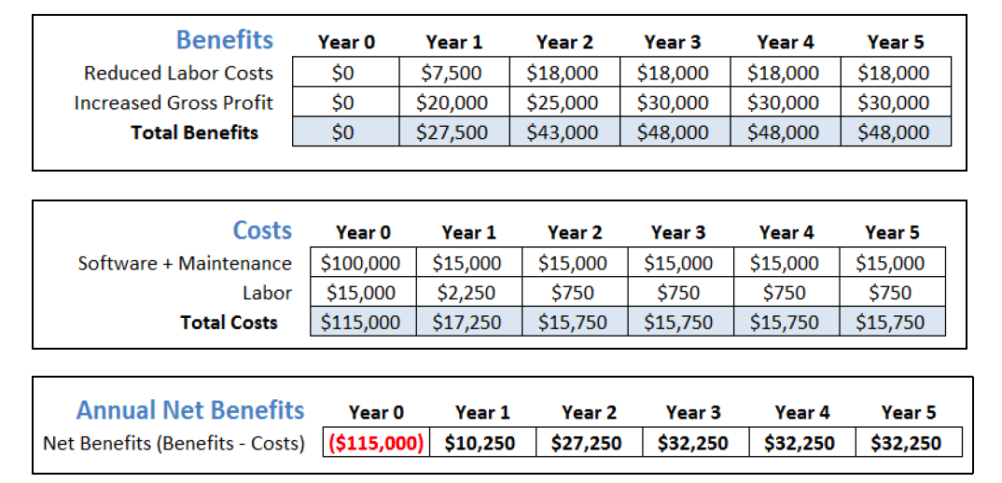
ROI for technology investments
Example : Purchase of a design SW will produce 2 benefits :
Cost / Benefit analysis

Slide 9
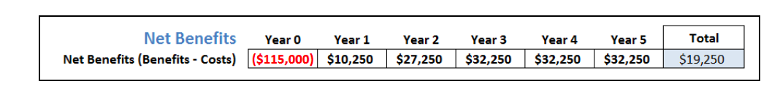
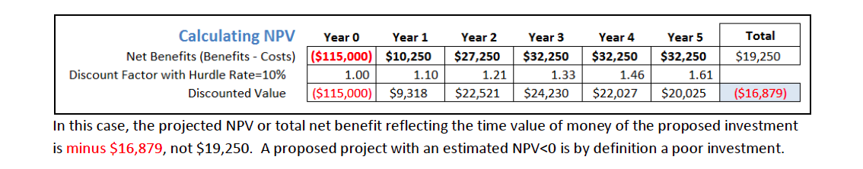
ROI for technology investments
Different Financial metrics to assess BCA
Return on investment = (Benefits – Costs) / Costs
On our example = 19,250 / 195,250 or 9,9%
NPV : Net present value

Slide 10
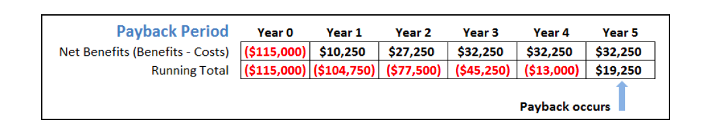
ROI for technology investments
Different Financial metrics (Con’t)
Payback period : time it takes for the benefits to outweight the costs
Profitability index : Future cash flows (Discounted or not) / Initial investment
On the example with discounted cash flows : 98,121 / 115,000 = 85% (<1, not good investment)

Slide 11
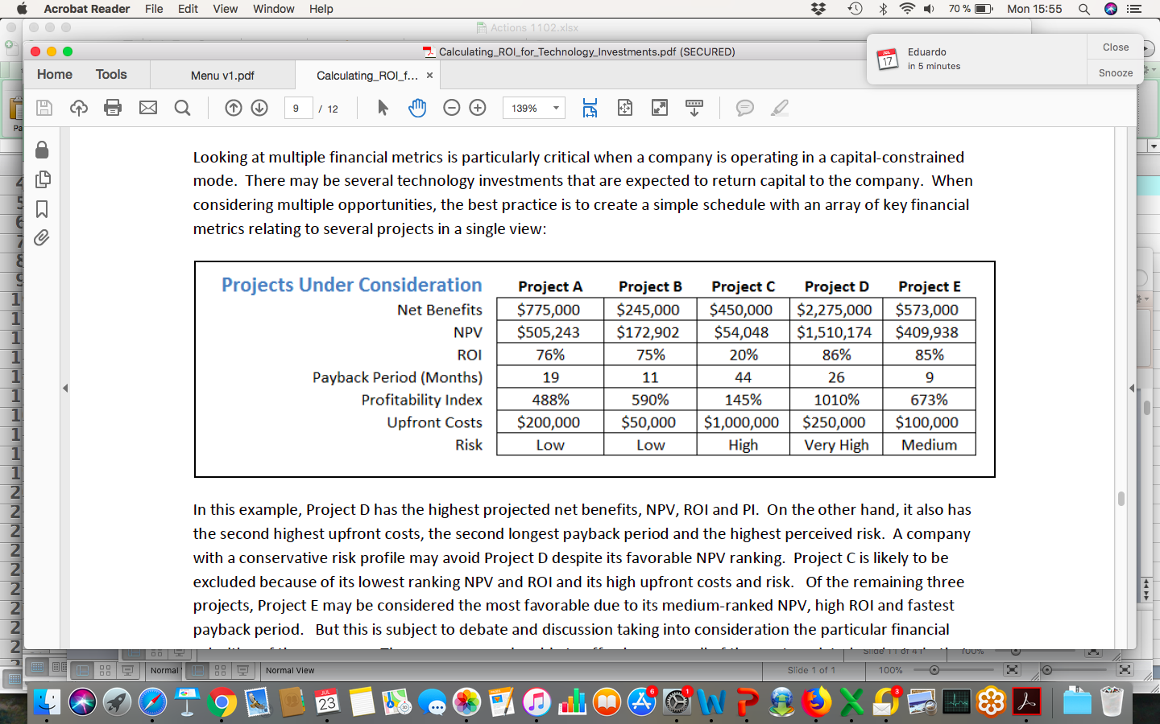
ROI for technology investments
BCA is one of the elements to be taken into consideration :

Slide 12
ROI for technology investments
BCA is an element in the decision making, other include cost and risk
Often a combination of Financial (ROI, NPV…) and risk is used…
Good practices :
Be conservative in benefits and costs assessment
Be transparent on the assumptions used
Iterate…
Follow up with post implementation results
KISS – Keep it Simple Stupid ! and use common sense…don’t get drown in technicalities….

Slide 13
Project value case

Slide 14
What is project value case?
A value case, or business case, is the fundamental analysis of the cost of a project, system cost, feasibility, risks, benefits and economic return. This analysis combines quantitative and qualitative data in a prioritized fashion to render a written, comprehensive, and defensible justification for undertaking a transformation.
The value case delivers four important benefits:
Organizational agreement - The value case, and the value case development process, is a format for the organization to reach agreement on initiatives and projects, goals and financial expectations.
Economic justification - The value case provides the hard numbers for costs and projected benefits to measure return on investment.
Documented proof - The value case is a tangible, referenced, written testament for the organization that can be used on an ongoing basis to reaffirm commitments and measure progress.
Confidence (vs. hope) - The value case replaces intuition, hope, and optimism with confident business decisions made on sound analysis.

Slide 15
What is project value case?
Despite their benefits, value cases are often not completed for even large, high-risk projects. There are several reasons, all of which can contribute to the failure of proper business justification. These include
skipping the value case because of enthusiastic mandates from management, limits
Not having the skills or bandwidth to complete one.
The value case helps make tough business decisions by providing clear economic justification for IT projects and initiatives.
More importantly, the value case is a process by which all necessary decision-makers come to agreement on the decision criteria and justification.
A less-than-perfect value case is better than no value case at all…

Slide 16
Practically project value case…
… is also about:
Project assessment and prioritization
Need to win consensus and win others
Need for a robust process & review framework
Sometimes require managing upwards
Requires common evaluation criterion
Need discipline… and common sense

Slide 17
Financial Benefits categories
Benefits category / Savings | Explanation
Operating costs reduction | Net reduction in costs the company is spending today and will stop spending as a result of doing the project
Cost avoidance | Cost avoidance is defined as the benefits realized by reducing / avoiding future expenditure although the projected expenditures have not been budgeted or obligated
Productivity gains | Productivity savings are defined as the time saved or freed up as a result of doing the project
Financial penalty savings | Savings resulting from financial penalties going away

Slide 18
Other Benefits categories
Revenue generation
Compliance
Customer satisfaction
Employee development / satisfaction
Process standardization
Data / system security
User experience
Brand image

Slide 19
Cost categories
Cost categories | Explanation
Business resource costs | Project team business resource costs (permanent, Temp or contractors)
IT resource costs | Project team IT resource costs (permanent, Temp or contractors)
Infrastructure (HW) costs | Servers, Telecoms equipment etc….
SW licence costs
Organization adoption costs | Training, communication etc…
Maintenance / support costs | Cost to support once project is live

Slide 20
Project assessment methods
Cost Benefit criteria:
Return on investment (ROI)
Payback period
Net present value (NPV)
Etc…
General criteria:
Strategic alignment
Risk level
Criticality level
Etc…
… And others you may have or may encounter…

Slide 21
Return on Investment (ROI)
A fundamental financial and business performance measure. This term means different things to different people, so it's important to clarify understanding if interpretation has serious implications. Many business managers use the term in a general sense as a means of assessing the merit of an investment or business decision.
In simple terms this the “profit” made from an investment. The investment could be the value of a whole business, or the investment could relate to a part of a business, a new product, a project, or any activity or asset with a cost attached to it.
The main point is that the term seeks to define the profit made from a business investment or business decision. Bear in mind that costs and profits can be ongoing and accumulating for several years, which needs to be taken into account when arriving at the correct figures.

Slide 22
Project ROI
Why is ROI Important?
It quantifies project value – Perhaps the most important aspect of ROI is its ability to show business leaders dollar/currency figures of a project’s worth. ROI turns the subjective into the objective, which can often turn uncertainty into support.
It can build stakeholder support – Tying a dollar/currency value to a project may help with a “go/no-go” decision. Many times, stakeholders want to see what the dollar/currency value is to them if they are to support a particular project. Without an ROI, that is very difficult to do.
It can uncover additional benefits – The process of calculating ROI forces practitioners to investigate benefits that might not have seemed obvious at project start.
It can lead to project prioritization – Once the decision has been made to launch a project, ROI helps determine the project’s ranking among other priorities; usually, projects with greater ROI are ranked higher and gain resource support more quickly.

Slide 23
Project ROI
How to Calculate ROI
ROI = [(Financial value – Project cost) / Project cost] x 100
Note: In looking at the formula, there are two components we need to determine: Financial value and project cost.

Slide 24
Project ROI
Financial value
Financial value is simply the project’s payback. Calculating value can sometimes be complicated based on the uncertainty of assigning actual dollars to a proposed outcome. The trick is breaking down the value into presently known components and then defining those components.
Project cost
The second unknown component of the ROI formula is project cost. Project cost is calculated by determining all project costs and expenses over time.
Note: If there is any ambiguity as to what the cost might be, it is advisable to always estimate higher. This will help prevent cost overruns, which will only delay the project.

Slide 25
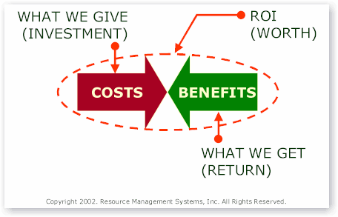
Project ROI

Slide 26
Project ROI example
If total project costs are $300,000 and expected gains are $360,000, the ROI will be:
ROI = [(Financial value – Project cost) / Project cost] x 100
[($360,000 – $300,000 ) / $300,000 ] x 100
Or 20%

Slide 27
Payback period
When we are managing a business or a project by cash-flow (versus income), we care very much about how quickly we get our money back. It is a reality that some companies (or project sponsors) choose the less-profitable investment if they get their money back faster.
The most common reasons for this decision would be if a company was strapped for cash, and did not want to use debt to finance operations.
Companies faced with a high level of uncertainty for their investments will also find payback period analysis attractive.
When using payback period to make investment decisions, companies will usually have a standard time period, such as two years or two quarters. Any project that has a payback period of less than the standard will be acceptable. Those projects that take longer to return the original investment than the standard period will not be acceptable.

Slide 28
Payback period
How to Calculate Payback period, when cash inflows are even:
Payback period = Project cost / Annual cash inflows
Notes:
There are two main problems with the payback period method:
1. It ignores any benefits that occur after the payback period and, therefore, does not measure profitability.
2. It ignores the time value of money.
Because of these reasons, other methods of capital budgeting, like Net Present Value, are generally preferred.

Slide 29
Payback period example
If a project costs $100,000 and is expected to return $20,000 annually, the payback period will be:
Payback period = Project cost / Annual cash inflows
$100,000 / $20,000
Or five years

Slide 30
Net Present Value (NPV)
NPV is a significant measurement in business investment decisions.
NPV compares the value of a dollar/currency today to the value of that same dollar/currency in the future, taking inflation and returns into account.
If the NPV of a prospective project is positive, then it is profitable and is worthy of consideration.
If negative then it's unprofitable and should not be pursued.
There are different and complex ways to construct NPV formulae, largely due to the interpretation of the 'discount rate' used in the calculations to enable future values to be shown as a present value. Corporations generally develop their own rules for NPV calculations, including discount rate.
Note: NPV is not always easy to understand for non-financial people. Wikipedia seems to provide a good detailed explanation if you need one.

Slide 31
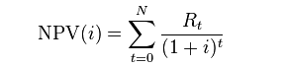
Net Present Value (NPV)
NPV is the sum of the PV (Present values) of incoming and outgoing cash flows over a period of time.
Present Value : based on the “compound interest” methodology
FV = PV (1+i) on 1 period
FV = PV (1+i) ^n
PV = FV / (1+i)^n
NPV definition

Slide 32
Net Present Value (NPV)
NPV accounts for time value of money by using discounted cash inflows (Discount rate).
Before calculating NPV, a target rate of return is set which is used to discount the net cash inflows from a project. Net cash inflow equals total cash inflow during a period less the expenses directly incurred on generating the cash inflow.
Advantage: Net present value accounts for time value of money. Thus it is more reliable than other investment appraisal techniques which do not discount future cash flows such payback period and accounting rate of return.
Disadvantage: It is based on estimated future cash flows of the project and estimates may be far from actual results.

Slide 33
Net Present Value (NPV)
Discount rate:
Discounting cashflows to achieve a Net Present Value (NPV) is not without problems but it has one great advantage it makes all the results directly comparable and it is transparent how you got there.
To help in understanding the Discount Rate it can be considered almost as the rate of return required by the investor which includes costs, risks and lost opportunities.
Therefore, the discount rate which is used for evaluating projects will vary between different firms or even between projects.
This means the discount rate value is not universal in time nor is it necessarily valid geographically on a country-wide basis.

Slide 34
NPV example
Even Cash Inflows:
Calculate the net present value of a project which requires an initial investment of $243,000 and it is expected to generate a cash inflow of $50,000 each month for 12 months. The target rate of return is 12% per annum.

Slide 35
NPV example
Solution:
Initial Investment = $243,000
Net cash Inflow per period = $50,000
Number of periods = 12
What is the Discount rate per period?
Discount rate per period = 12% ÷ 12 = 1%
Net Present Value
NPV ≈ $319,754

Slide 36
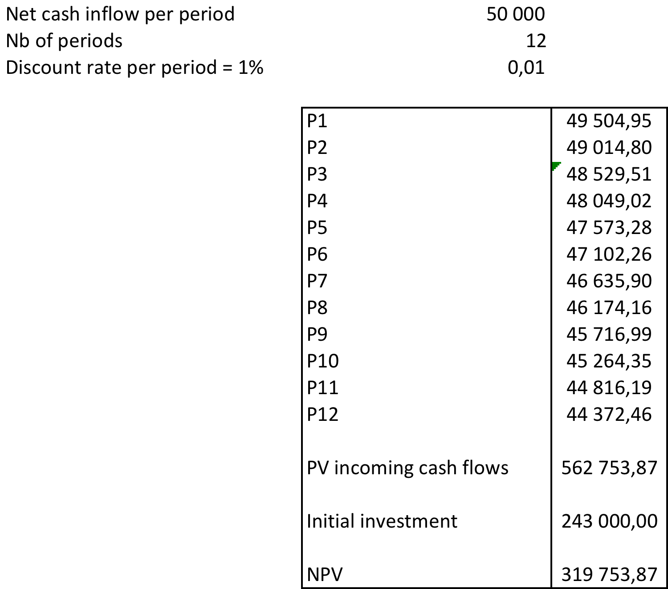
NPV example

Slide 37
NPV’s discount rate exercise
You have $3mil and need to decide between 2 options:
Option A: borrow $1mil with 15% interest rate, then invest 4$mil in a project
Option B: Invest $2mil in another project. You might lend the $1mil remaining for 10% interest rate
Question: To calculate the NPV on your option A project, what discount rate should you use? 10% or 15%?

Slide 38
NPV’s discount rate exercise
Discount rate for option A’s project:
Opportunity cost for you is 10%. That seems to be the interest rate that you can earn by lending the money to borrower or bank.
So, you should choose the discount rate of 10% for NPV calculations.
However, this applies to your second project.
But for the first project is based on 25% of the investment funded by borrowing whose cost is 15%.
So, your weighted cost of funds is (0.75 x 10 +0.25 x 15) = 11.25.
So, the discount rate should be 11.25% for the first project.

Slide 39
Cost benefit analysis using NPV
The following is a list of steps that comprise a generic cost-benefit analysis:
List alternative projects/programs.
List stakeholders.
Select measurement(s) and measure all cost/benefit elements.
Predict outcome of cost and benefits over relevant time period.
Convert all costs and benefits into a common currency.
Apply discount rate.
Calculate net present value of project options.
Perform sensitivity analysis.
Adopt recommended choice.
Note: Sensitivity analysis is used as part of what-if analysis. It is a technique used to compare different scenarios and their potential outcomes based on changing conditions/variables.

Slide 40
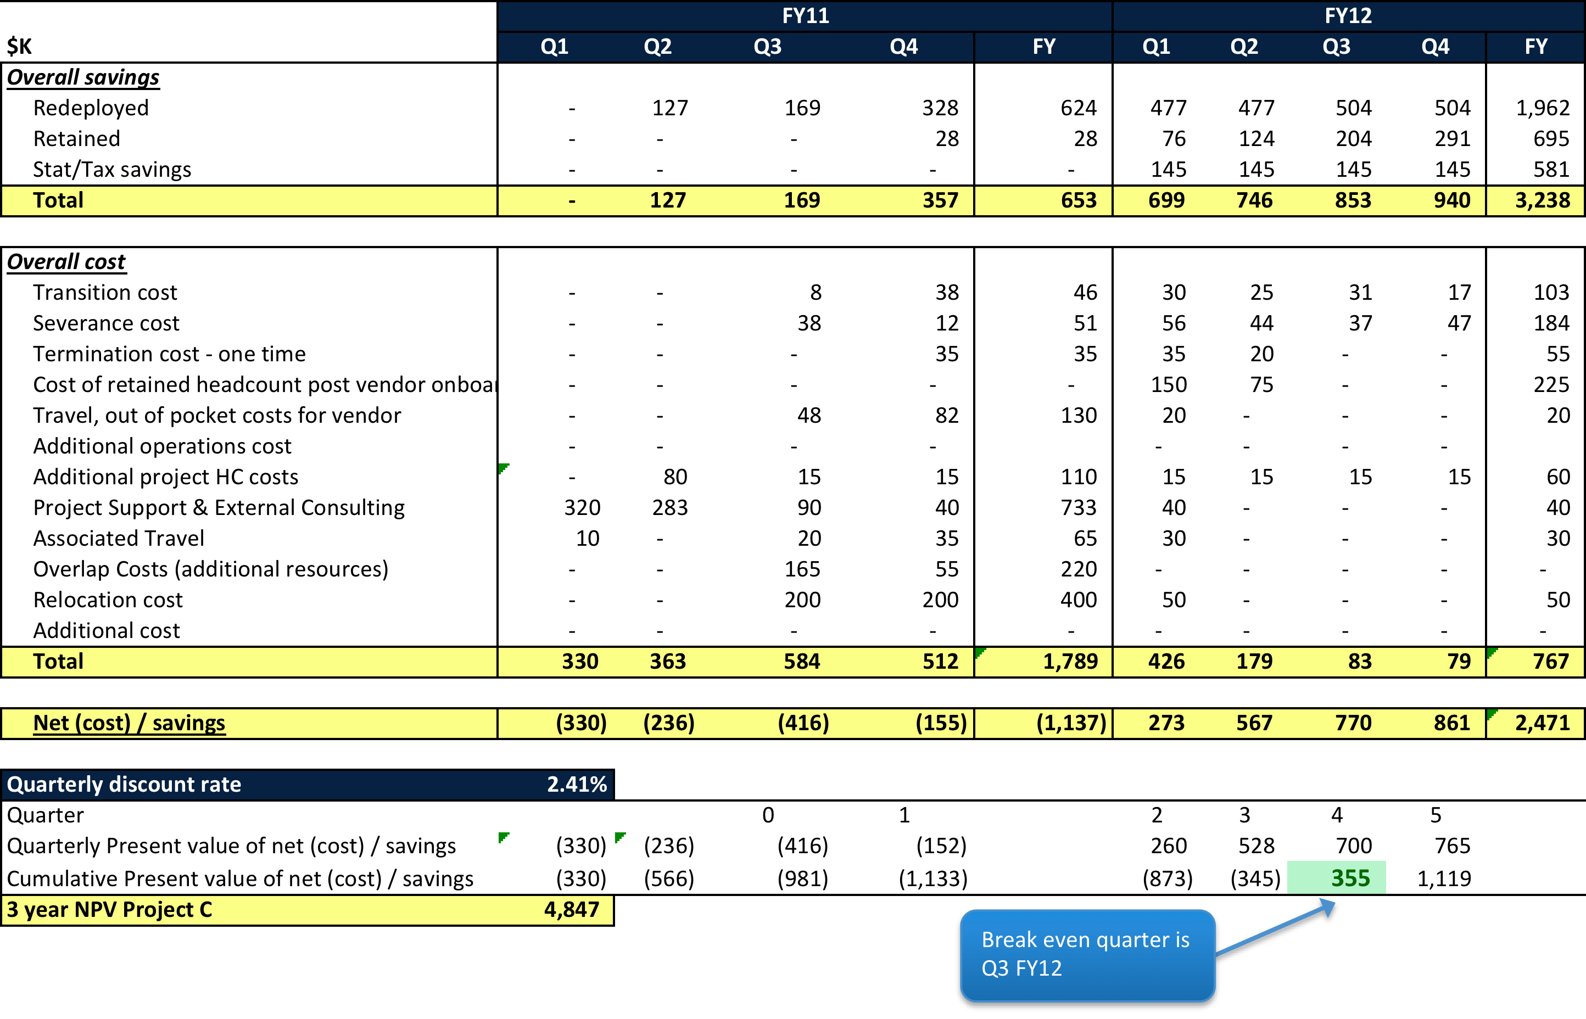
Cost Benefit analysis example

Slide 41
Thank you!
See you next time

